Slide 1
Better Governance, Better Livelihood, and Better Industry
New ICT, Creating a Smart City Nervous System

Slide 2

Action Speaks Louder Than Words:
An Inspiring Smart City Story in Longgang, Shenzhen with Huawei

Slide 3
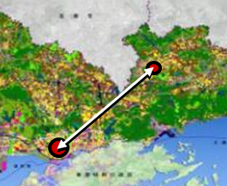
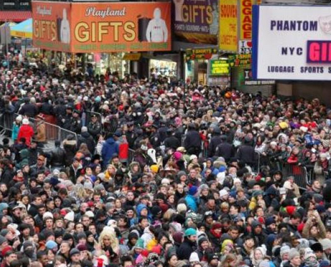
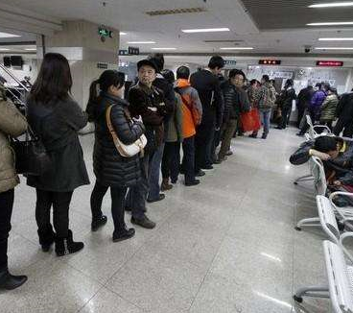
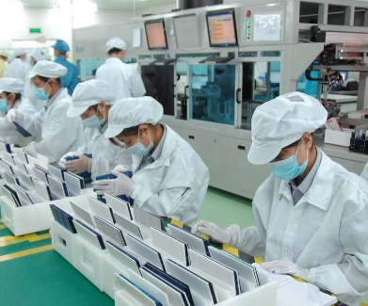
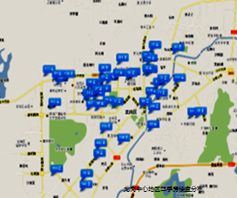
Challenges Faced in Longgang District
Decentralization of core resources
Lack of development impetus due to geographical constraints
Difficult social governance
Inefficient public services
Mainly low-end
industries
Covering an area of 385.94 square kilometers, Longgang has a population of 4.25 million, among which 70% is floating population. Low-end industries account for 90% of total industries.

Slide 4
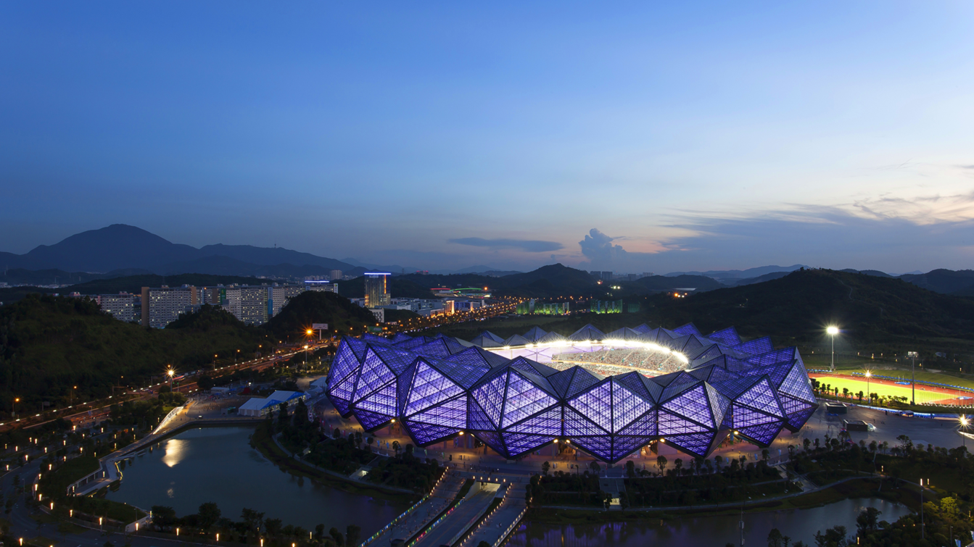
Smart Longgang High-Level Design: 5 + 6 + 11, Data Integration, Benefits for People, and Smart Management
Smart infrastructure zone
Smart management
Benefits for people
Smart
center
Smart
government
Smart
governance
Smart
environmental
protection
Safe
City
Smart
education
Smart
transportation
Smart
healthcare
Smart
community
Smart
campus
Smart
industry
...
Efficient government collaboration zone
Smart application layer
SaaS
Inclusive public services zone
Data integration
Data and services
Unified internal portal services
Unified external portal services
Unified map services
Unified IoT services
Refined social management zone
Unified Big Data services
Unified O&M services
Unified security services
……
Map: geographic information layer
Database: data management layer
Cloud: computing and storage layer
Network: network communications layer
Terminal: IoT sensing layer
A set of maps (geographical information database)
Livable urban environment zone
One database group (basic database)
Unified
infrastructure
One cloud (distributed cloud architecture)
Modern industry development zone
One network (converged network)
Sensors & actuators
Controllers

Slide 5

Enabling “One-Window" Government Services Through Cloud Transformation
Online services
Offline “one-window" handling
Approval process
70%+
Cross-agency data sharing
33%+
50%+
Average waiting time

Slide 6

Breaking Data Silos to Facilitate Data Sharing and Improve Service Efficiency
Case: free education application for children of migrant workers in Shenzhen
Apply online and submit materials offline only once.
Visit multiple departments for several times, taking lots of time and efforts.
At present: 2 days
Before: 20 days

Slide 7

Multi-Planning-in-One: Making City Planning More Reasonable with Cloud and Big Data
Unified base map, supporting reasonable decision-making
Data sharing, avoiding repeated construction
Joint review and approval, improving efficiency by 50%

Slide 8

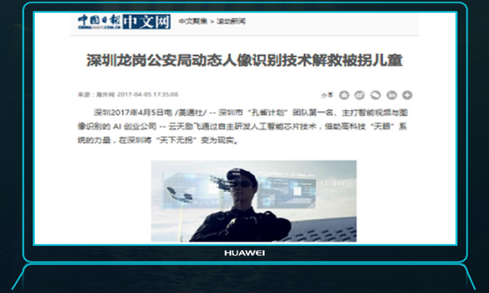


Improving Public Safety with Video Cloud and Artificial Intelligence
3
4
Video investigation
Facial recognition
2
A 3-year-old child was missing.
5
15 hours
Big Data analytics
1
Received an alarm from the public.
6
At 6: 00 a.m., January 27, 2017,
Wuchang Railway Station,
the lost child was rescued.
The crime rate is decreased by 28.79%.
The case handling efficiency is improved by 50%.
2016 to 2017

Slide 9


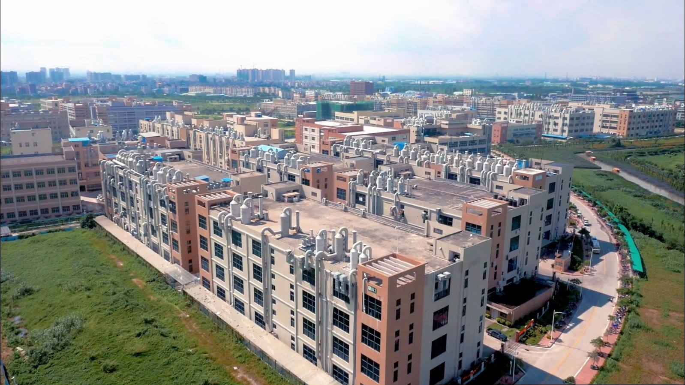
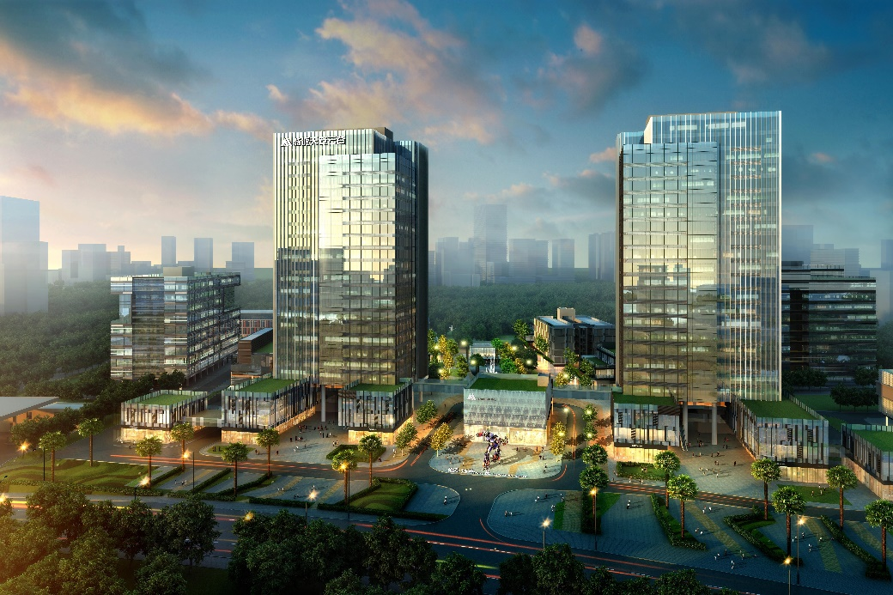

Innovating Through SMAC to Build a Smart Campus and Boost Industry Upgrade
Gangtou Industrial Area in 2012
Tian'an Cloud Park in 2017
Low-end processing, extensive management, and CNY200 million output
High-tech industries with digital operations, and CNY100 billion output
*SMAC: social, mobile, analytics, and cloud computing

Slide 10
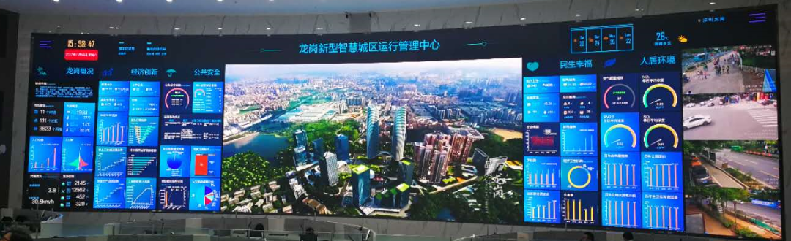
IOC Improves City Management and Decision-Making Efficiency Based on Big Data
Visualized situation reports
Operation monitoring
Decision-making support
United command
Comprehensive governance
Longgang Smart Operation Management Center
Make full use of Big Data analytics to comprehensively display the economic and social operating status of Longgang District. In this way, a command platform is set up for efficient decision-making and precise dispatching needed for better city management, building a 'smart city brain' in Longgang.
IOC: intelligent operation center

Slide 11
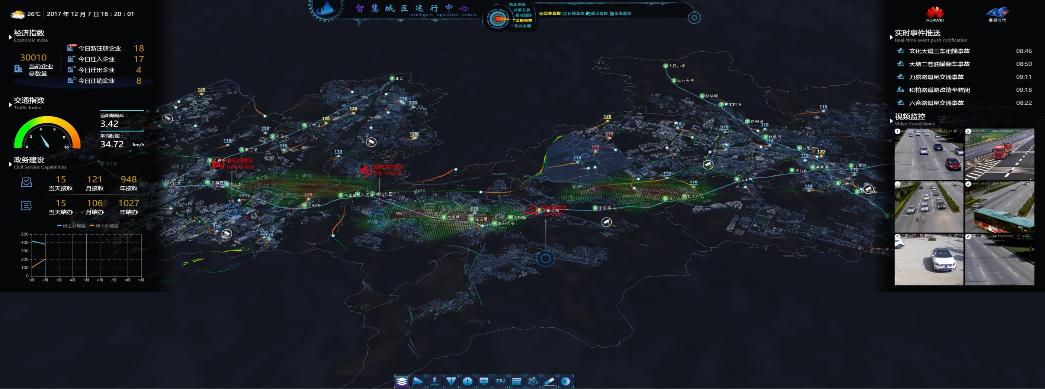
Multi-dimensional Insights into a City from Macro to Micro by IOC
Overall situation (macro)
Regional monitoring (meso)
Municipal maintenance (micro)
At the macro level, display land planning, economy, transportation, population, and ecological environment, and centrally manage information related to city operations, such as water supply, power supply, parking, streetlights, water affairs, and agriculture. Compare and analyze the information from each layer.

Slide 12
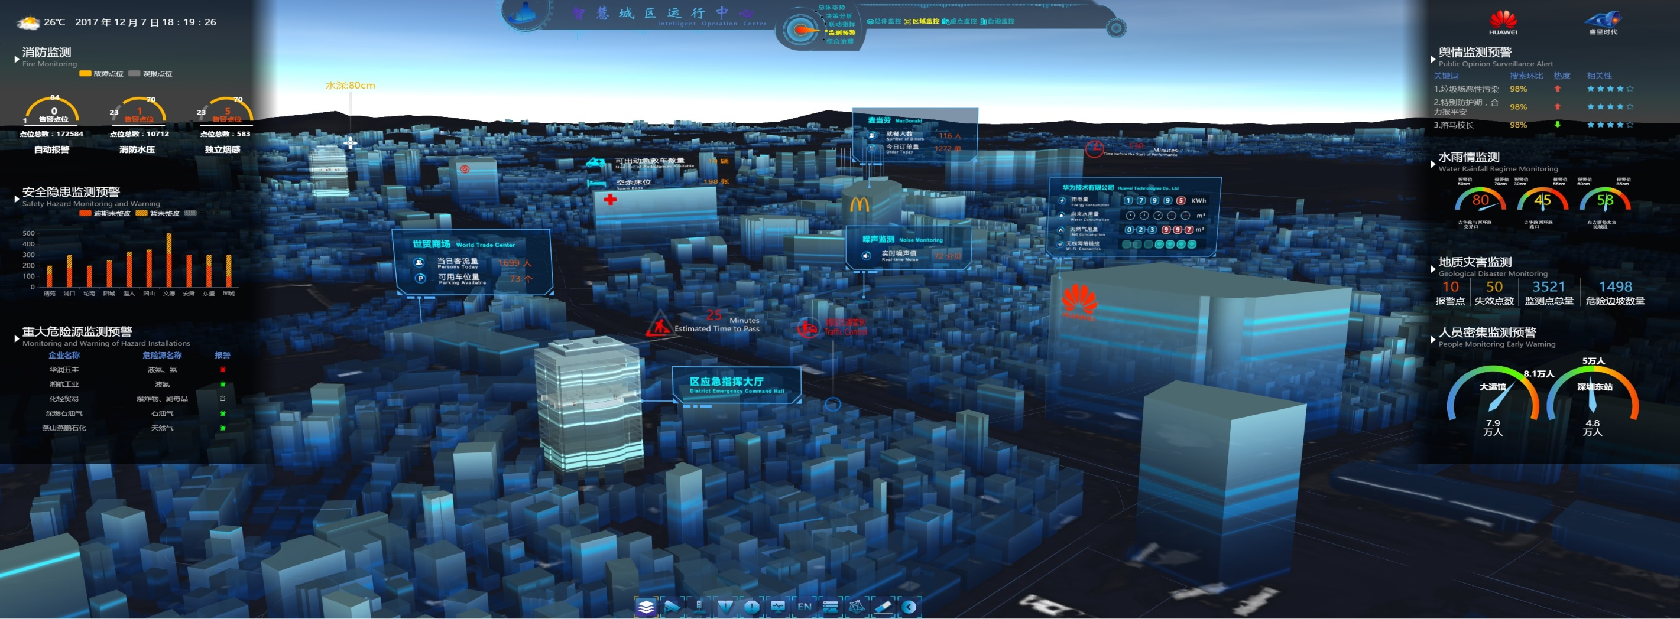
Multi-dimensional Insights into a City from Macro to Micro by IOC
Overall situation (macro)
Regional monitoring (meso)
Municipal maintenance (micro)
Focus on key areas of a city based on the decision-making requirements. Use Big Data analytics to present service data of those areas, such as buildings, fire protection, sanitation, energy consumption, public opinions, and surveillance in key venues. In this way, we can flexibly cope with emergencies in the region.

Slide 13
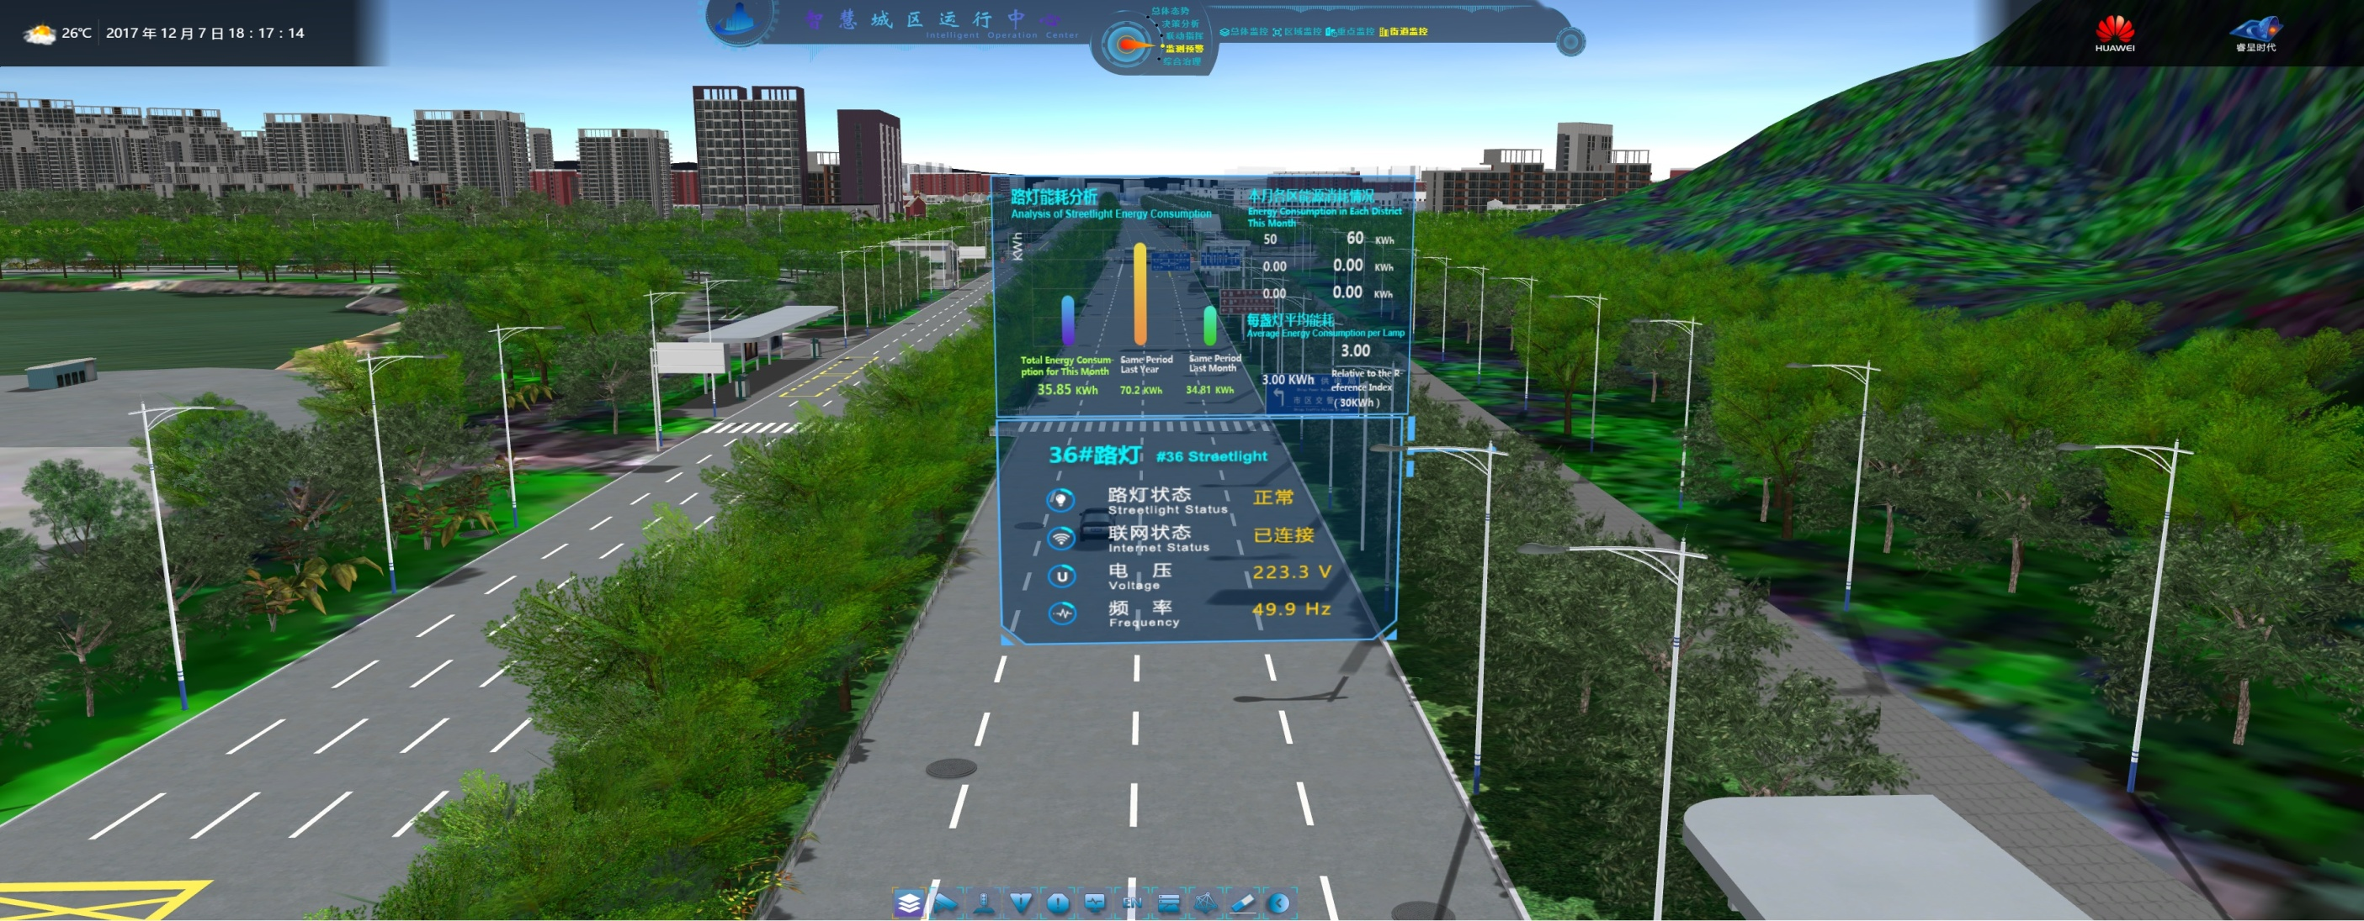
Multi-dimensional Insights into a City from Macro to Micro by IOC
Overall situation (macro)
Regional monitoring (meso)
Municipal maintenance (micro)
Based on the IoT data, monitor the distribution and operating status of facilities along key streets, including streetlights, manhole covers, and water, electricity, heating, and gas lines. In this way, maintain facilities in real time and improve public services.

Slide 14
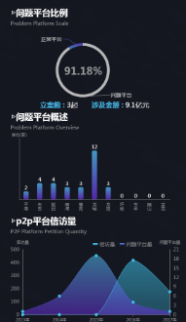
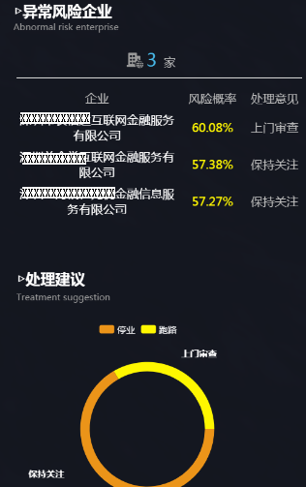
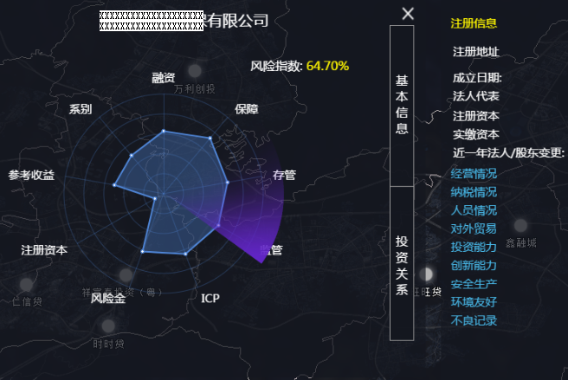
IOC Helps Mayors Develop Better Policies to Support Regional Economic Development with Enterprise Profiles.
Regional risk indicator statistics
Abnormal enterprise monitoring
Enterprise health profile
Problematic platform ratio
Enterprises with abnormal risks
XX Company
Registration info
Forecast
models
Registered address
Normal platform
3
Enterprise
Risk Probability
Risk probability: 64.70%
Establishment data
XX Internet Financial Services Co., Ltd.
Suggestion
Financing
Legal person
Problematic platform
Investigation
Category
Assurance
Basic info
Registered capital
Number of filed cases: 3
Involved amount: CNY910 M
XX Internet Financial Services Co., Ltd.
Attention
Paid-in capital
Problematic platform overview
Legal person/shareholder change during the past year
Monitoring
indicators
XX Financial Information Services Co., Ltd.
Attention
Reference profit
Custody
Operations
Tax
Suggestion
Personnel
External trade
Closure
Runaway
Registered capital
Supervision
Investment capabilities
Economic
data
P2P platform petition volume
Investment relationship
Innovation capabilities
Investigation
Secure production
Risk fund
ICP
Environmental-friendly
Bad records
Attention

Slide 15




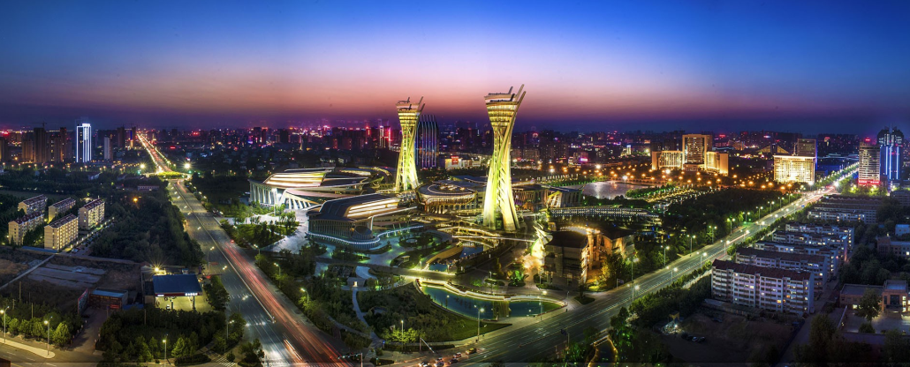






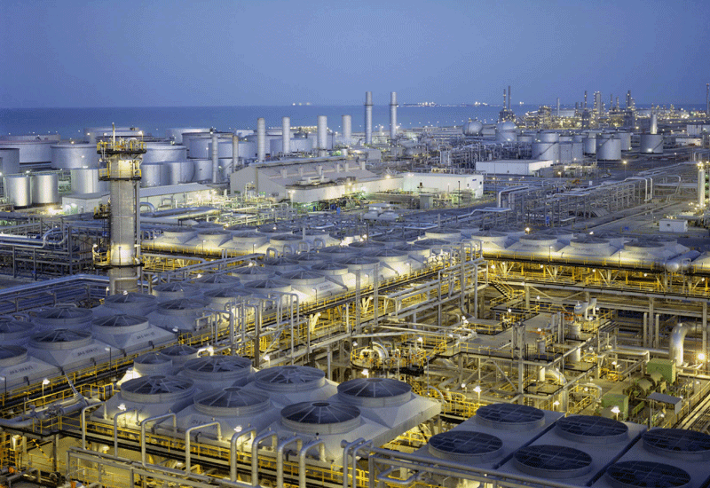

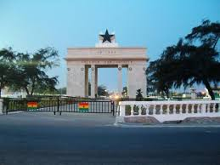





Huawei Actively Contributes to Global Smart City Construction and Sets Footprint in 120+ Cities in 40+ Countries.
Russia
UK
Weifang, Shandong
Moldova
Netherlands
Russia
Shanghai
Moscow
Spain
UK
Hungary
Moldova
Mongolia
Spain
Italy
Turkey
Tajikistan
Dunhuang, Gansu
Egypt
China
Saudi Arabia
Pakistan
Yanbu, Saudi Arabia
Laos
Ecuador
Italy
Ethiopia
Singapore
Venezuela
Ghana
Ghana
Kenya
Longgang, Shenzhen
Ecuador
Zambia
Tanzania
Indonesia
Bolivia
Angola
Indonesia
Mozambique
Pakistan
Bolivia
Kenya
Notes:
目前华为平安城市已经遍布全球, 你可以看到, 华为平安城市已经服务于全球30多个国家, 100多个城市, 4亿人。
华为的平安城市表现到底如何呢？ 下面我们来听一听来自客户的声音。
------------------------------------------------------------------------------------------------------------------------
Here you CAN see that, Huawei innovative ICT based Safe City Solution Has already Served 400M population, 100+ Cities, in 30+ Countries, 5 continentes
What is the performance after our deployment , let’s hear the voice from the service providers and end users.

Slide 16
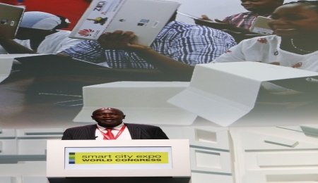
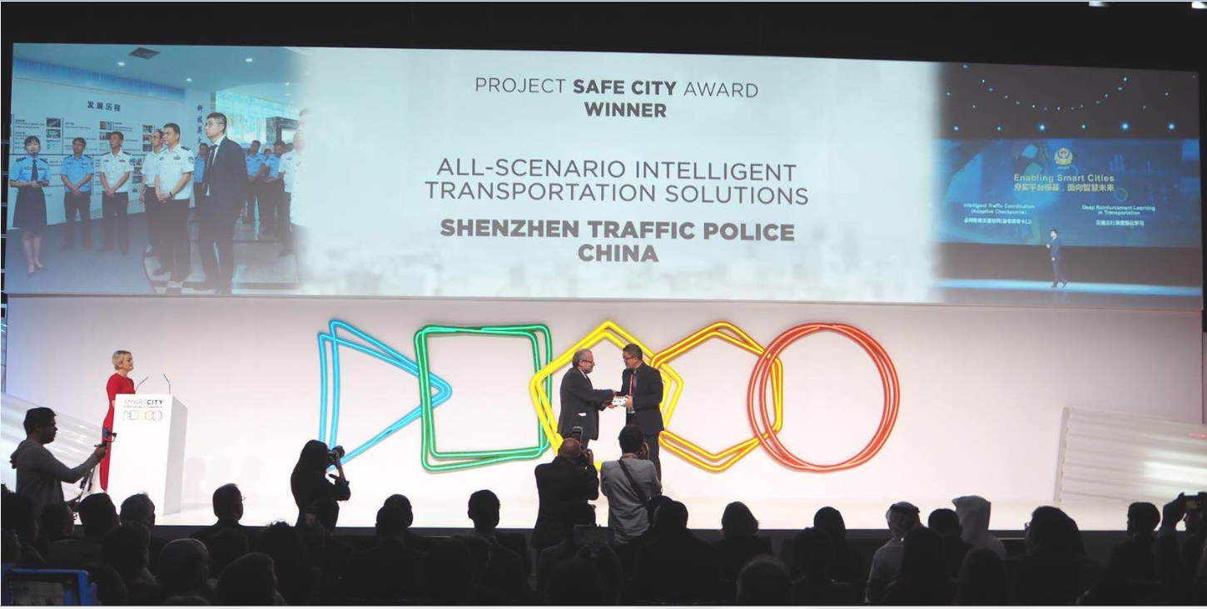
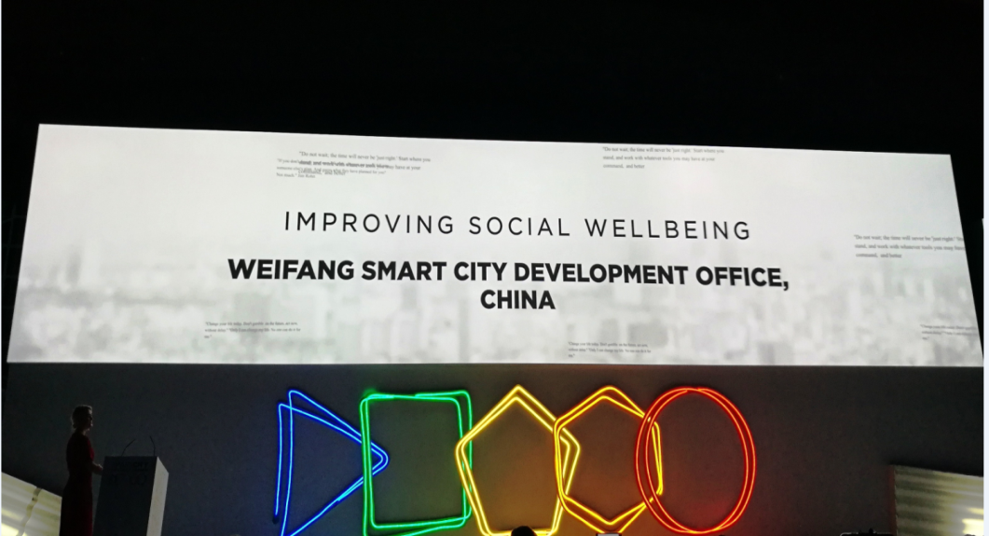
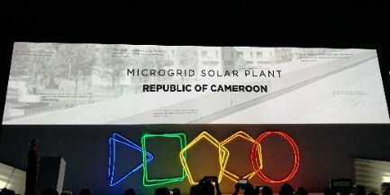
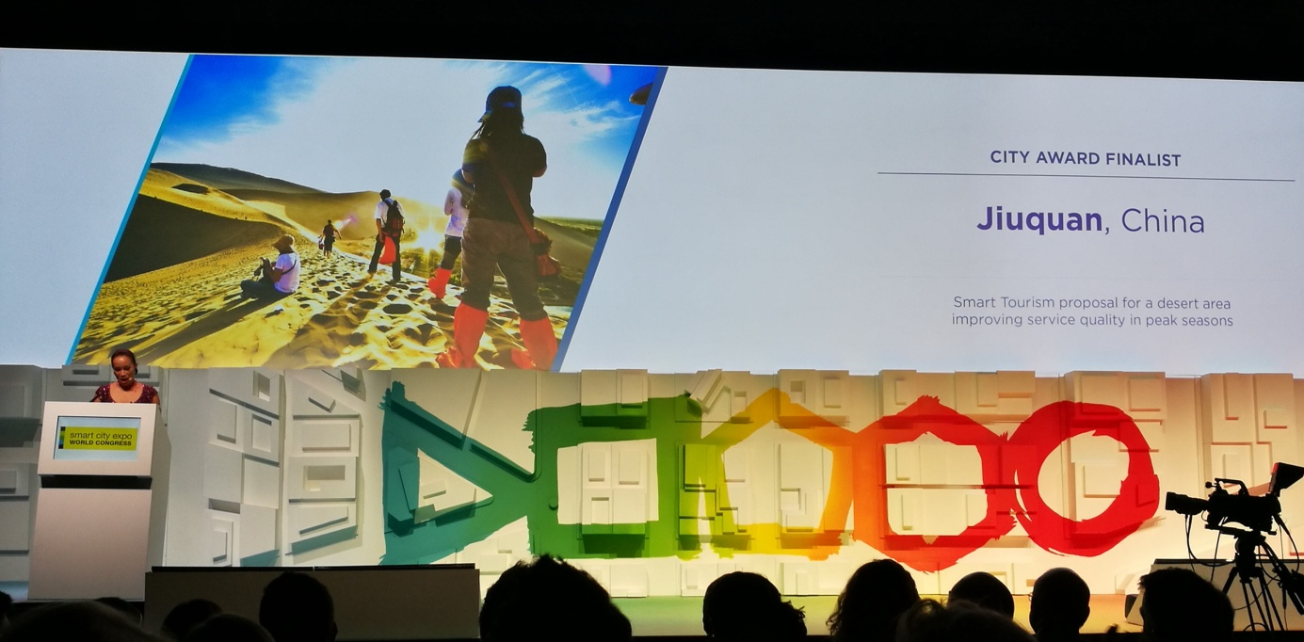
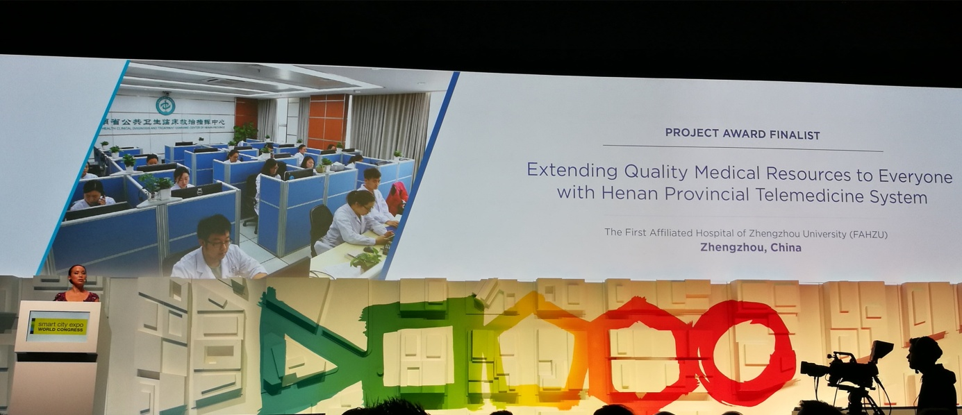
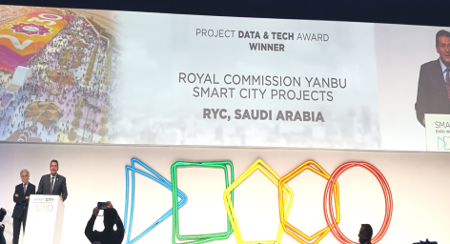
Huawei Has Helped Seven Cities Win International Smart City Awards in Recent Two Years.
Smart City Expo World Congress
2016 and 2017
Yanbu, Shenzhen, Weifang, Dunhuang, Cameroon, First Affiliated Hospital of Zhengzhou University, and Kenya

Slide 17
Huawei Smart City Solution

Slide 18






Leading New ICT, Building a Smart City Nervous System

Slide 19
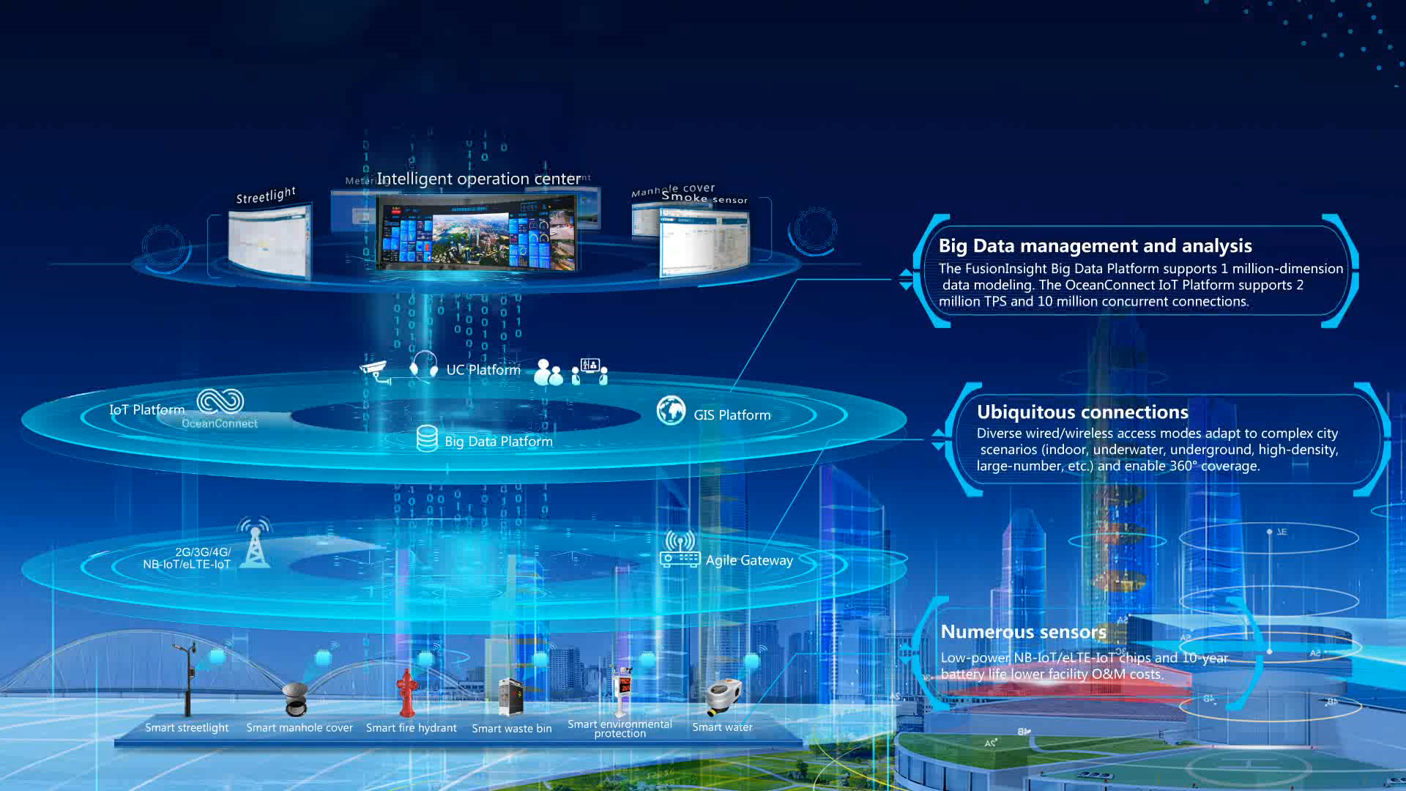
Nervous System, Building a Smart City with All Things Sensing, Connected, and Intelligent
Notes:
讲解要点:
在研发领域持续强力投资, 是华为的重要战略。华为坚持每年将10%以上的销售收入投入研究与开发。2016年, 从事研究与开发的人员约80, 000名, 占公司总人数45%, 研发投入达到6, 391百万元, 占总收入的14.6% 。近十年累计投入的研发费用超过人民币300, 000百万元。
截至2016年12月31日, 华为加入了360多个标准组织/产业联盟/开源社区, 担任超过300多个重要职位, 在IEEE-SA /BBF /ETSI /TMF /WFA / WWRF /OpenStack /Linaro / OPNFV和CCSA等组织担任董事会成员。2016年提交提案超过6000 篇, 累计提交提案49, 000篇。
截至2016年12月31日, 华为累计专利授权为62, 519件；申请中国专利57, 632件, 外国专利申请累计39, 613件。其中90%以上为发明型专利。
**********************************
Slide Owner: Wang Jie (00286887), Corporate Marketing Dept
Latest update: Jan, 2017
Recommended target audience: all
**********************************
更多信息:

Slide 20
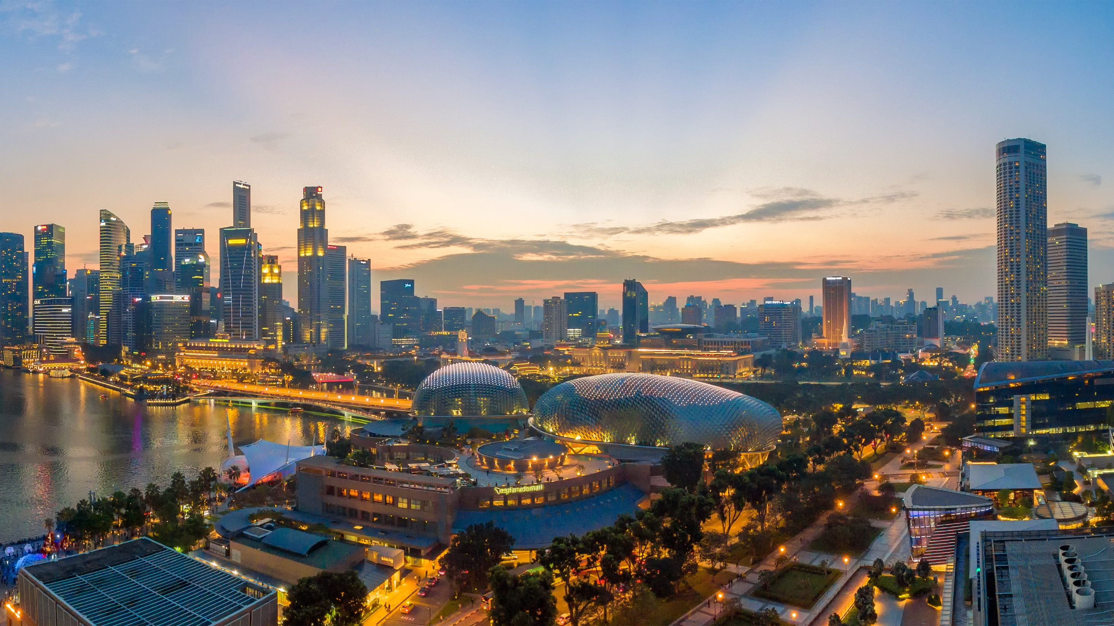
Sensing
Connection
Intelligence

Slide 21
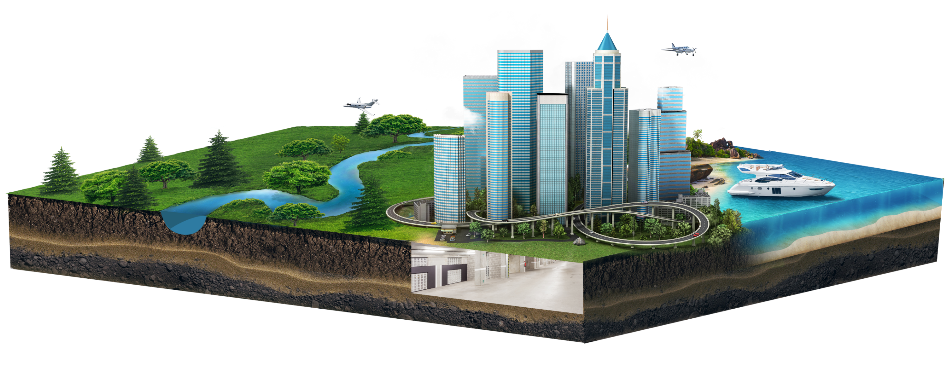

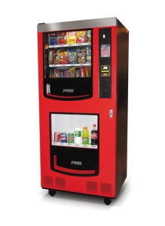
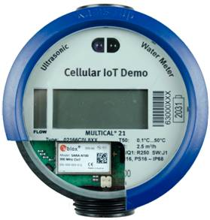

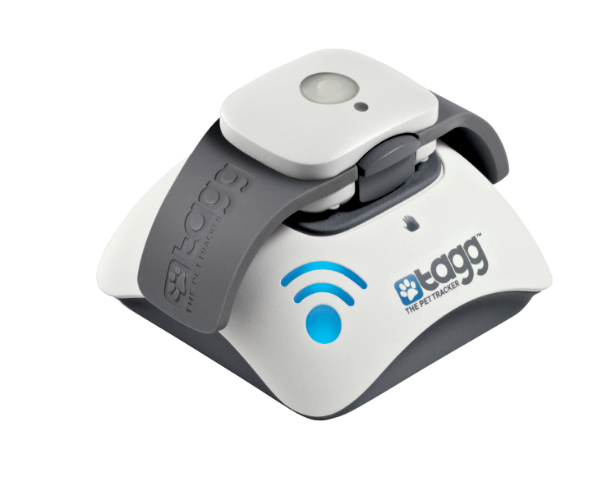
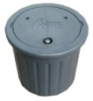

NB-IoT/eLTE-IoT, the LPWA IoT Technologies Best Suited for Smart Cities
2020
100, 000 connections/cell (100 times that of 4G)
Battery life of 10 years (5 times that of 4G)
3 billion
Cellular IoT connections
Unmatched signal penetration (workable in water or underground)
7X
2015
400 million
Cellular IoT connections

Slide 22
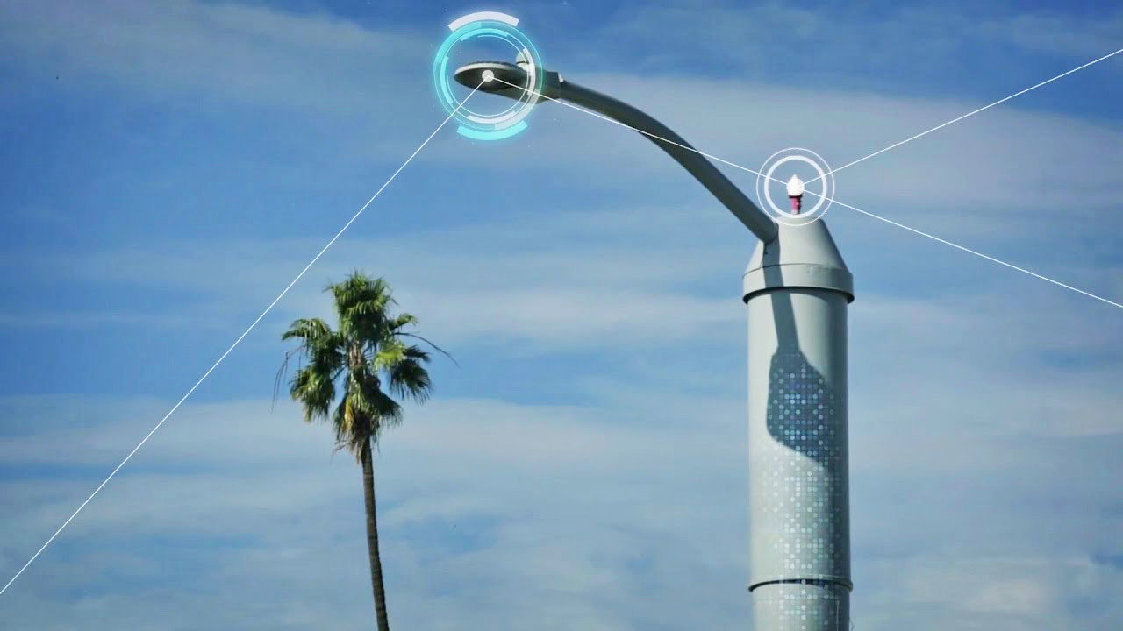
Smart Streetlight, Ideal for Energy-Saving City Construction
More than 40, 000 streetlights in Weifang have been reconstructed based on NB-IoT. As a result, the O&M efficiency is improved by 45%, the lighting rate is increased by 25%, and the annual electricity consumption is reduced by 6.8 million kWh.
Natural light sensing control
IoT policy control
Information release/billboard
Air monitoring
Public Wi-Fi coverage
Video surveillance
Emergency call button

Slide 23
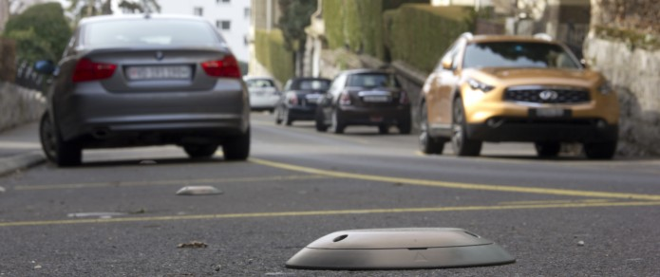
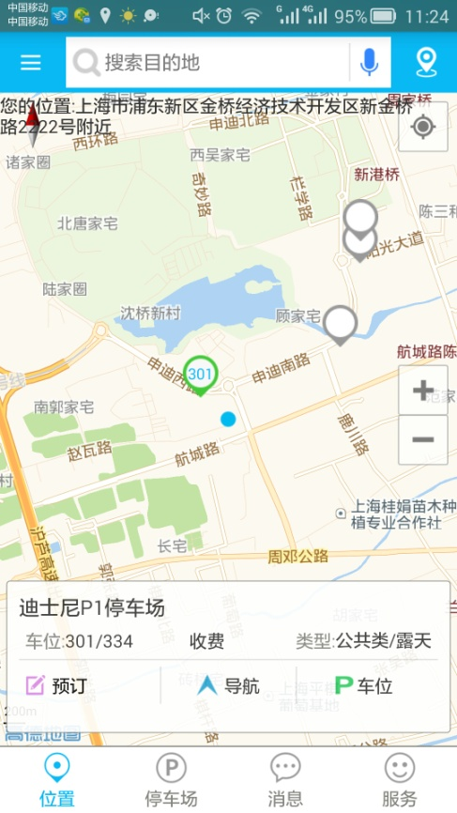
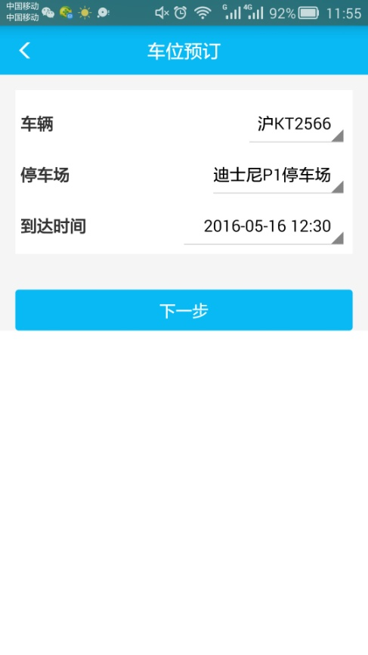
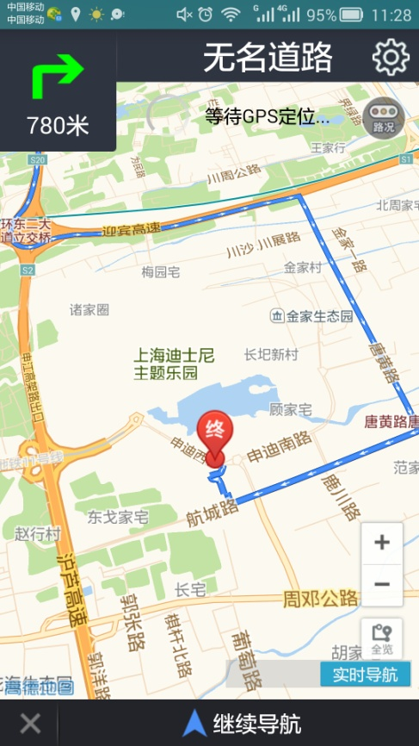
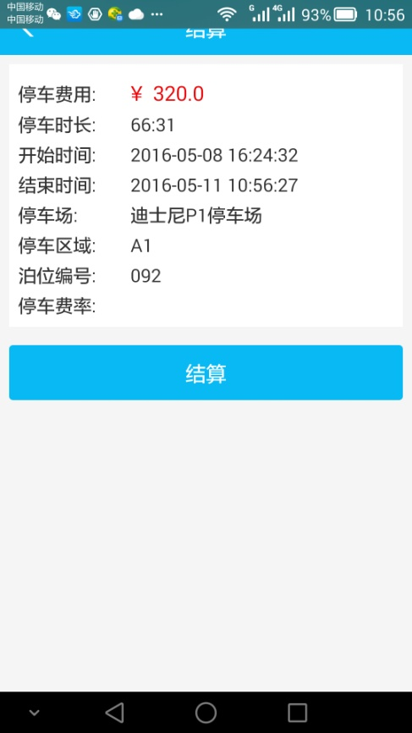
Smart Parking, Delivering Brand-New Parking Services Downtown
Regulate drivers' behavior to ensure reasonable usage of parking space.
Parking space query
Reservation on mobile phone
Driving navigation
Quick payment
Accurately and quickly detect parking space occupation status.
Yanbu, Saudi Arabia: By using the eLTE, the city has improved parking space utilization by 25%, and reduced labor costs by 30%.

Slide 24

Smart Water, Giving a Real-Time Full Picture of the City Lifeline
Weifang promotes 'smart river chief' solution based on eLTE to know water state and quality in real time.
Water quality monitoring
Water state monitoring
(flow velocity and liquid level)

Slide 25
Sensing
Connection
Intelligence

Slide 26

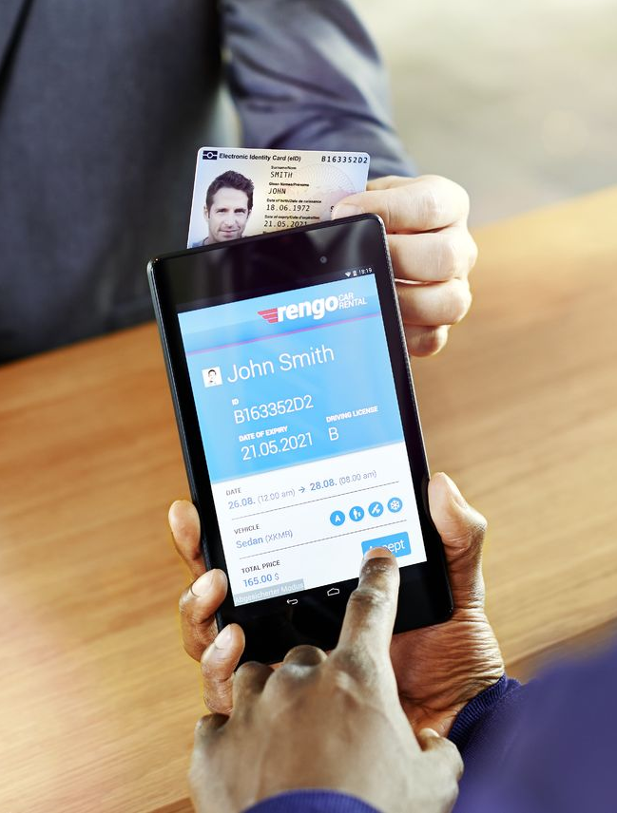



eLTE, Building a Secure and Reliable Government Private Network
Mobile
government
Video backhaul
Policing
trunking
Municipal
management
Broadband and narrowband integration based on 4.5G technology; wireless IoT with licensed and unlicensed spectrums
Large-capacity narrowband IoT, 50, 000 connections per base station

Slide 27
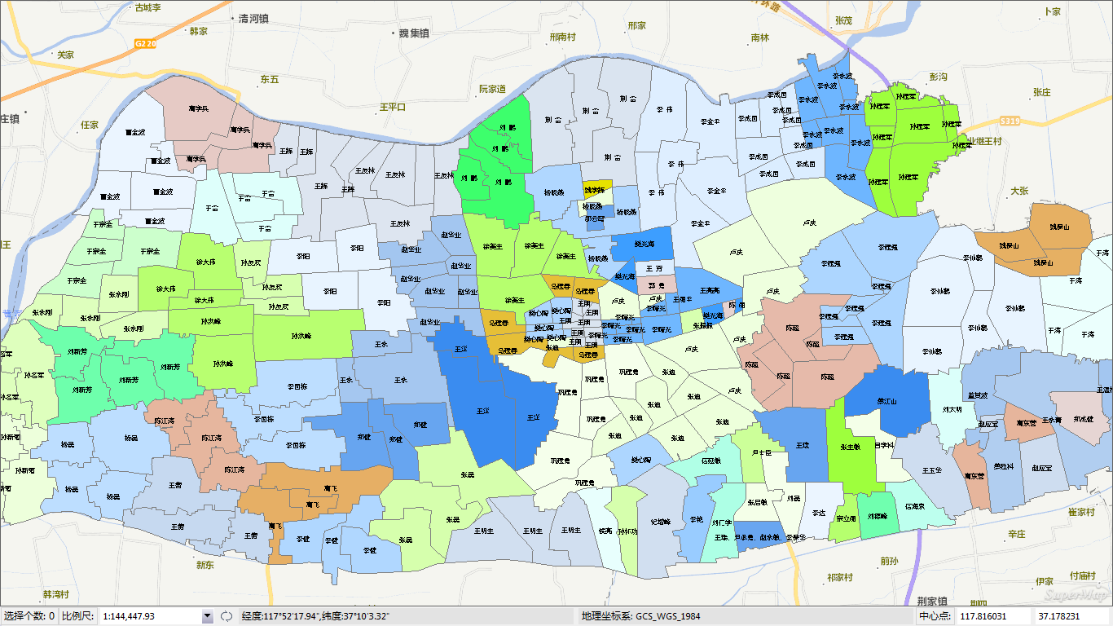

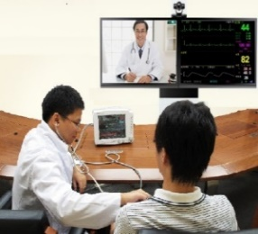
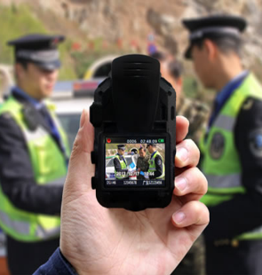





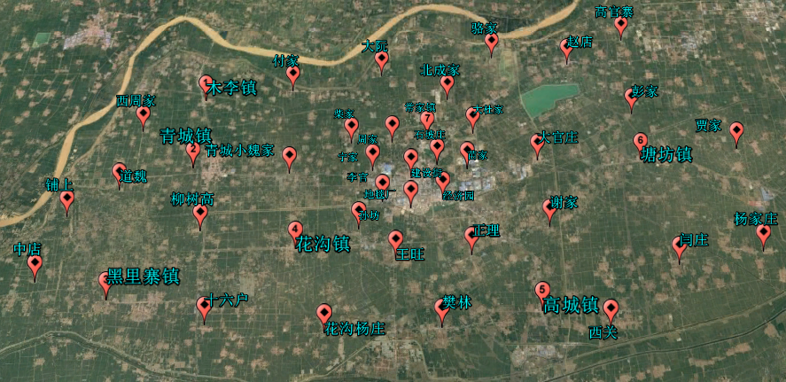
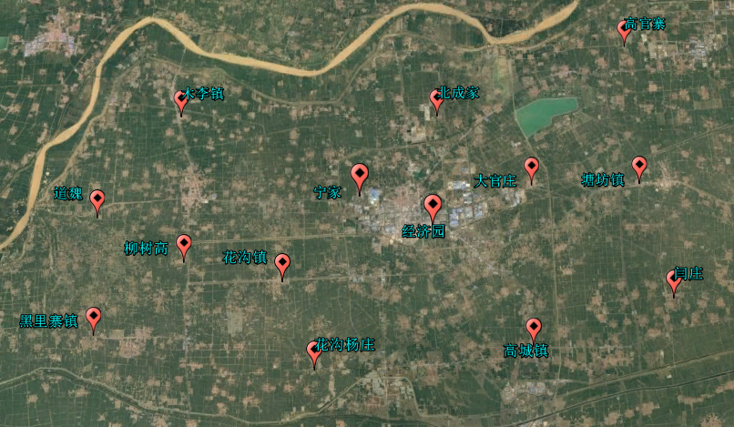
Gaoqing, Shandong: eLTE Private Network Planning Helps Build a Role Model of County-Level Smart City
Grid-based Management
Smart Healthcare
Smart Environment Protection
Smart Streetlight
Smart Parking
Smart Agriculture
Smart Municipal Administration
Mobile Policing
Smart Water

Slide 28
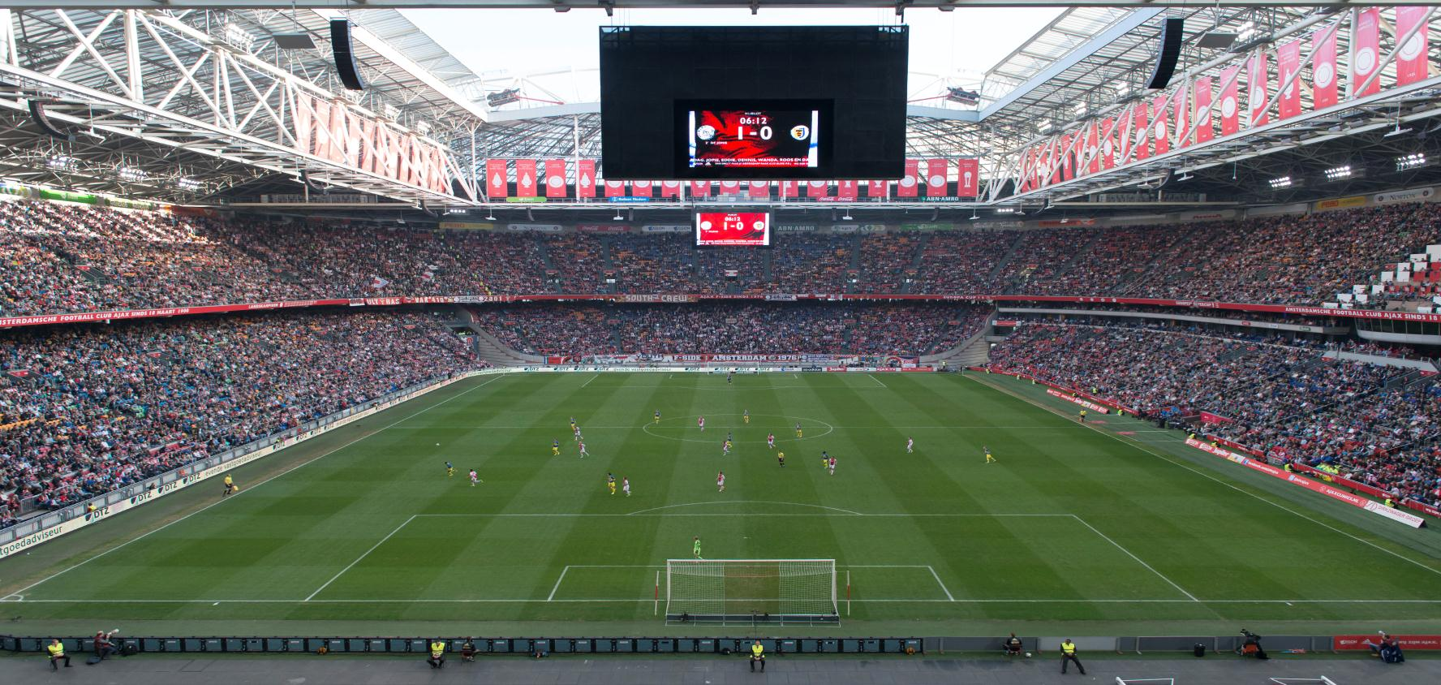

High-Density Wi-Fi, Improving Wireless Broadband Access Experience
80, 645 spectators
24, 000 concurrent connections
100% coverage
Ultra-large scale and ultra-dense
Concurrent connection rate 50%
Without blind spots

Slide 29
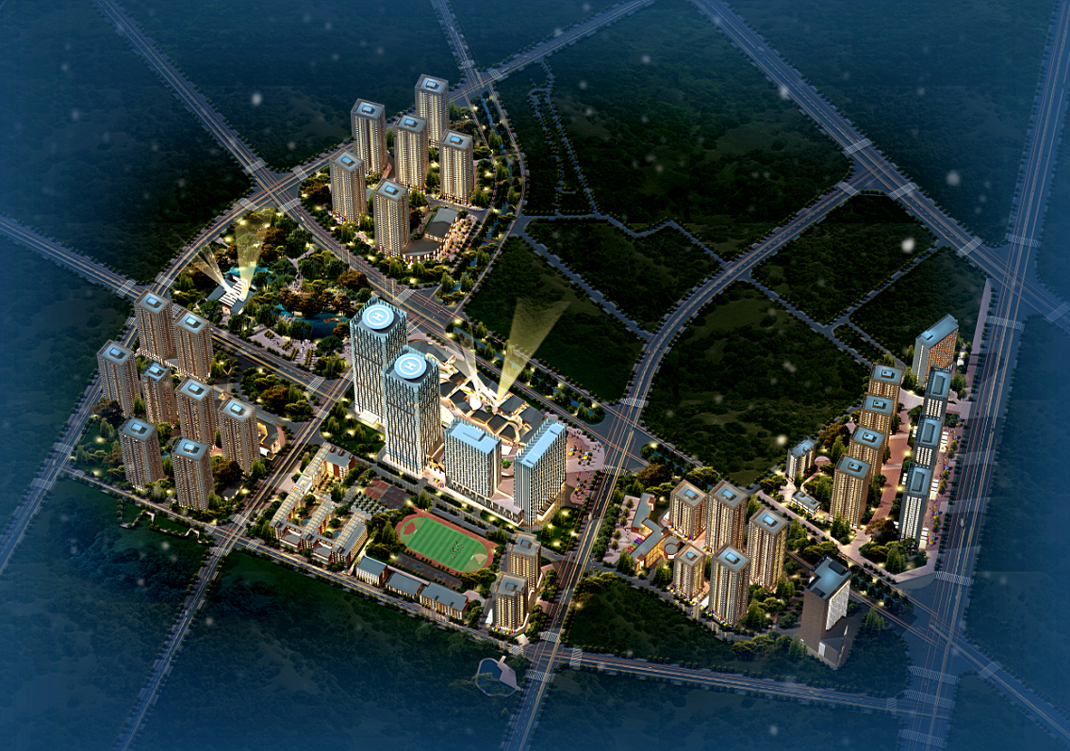
Agile All-Optical Network, Supporting Smart Life, Office, and Business
One fiber for multiple services
Simplified architecture and easy O&M
Simple
Active devices replaced by passive devices
Copper cables replaced by optical fibers
Reliable
Flexible
Open cloud access
Centralized device management
Residence: 5, 000
Store: 1000
Large shopping mall: 1
4-star hotel: 1
Office building: 7
5-star health center: 1
School: 2
Parking spot: 10, 000
Population: 100, 000–120, 000
Project Name: Guangfu Community
Total land area: 0.66 million square meters
Total construction area: 1.6 million square meters

Slide 30
Sensing
Connection
Intelligence

Slide 31


IOC Acts as the City Brain and Supports Scientific City Management and Decision-Making based on Big Data.
Economy
Warning
Management data
Transportation
Water affairs
Awareness
Decision-making
Environment
Emergency
City management
Action
Internet data
Education
Healthcare
Government
Security
Public opinions
IoT data

Slide 32

Big Data Requires Big Pipes and Large-Scale Computing Capabilities.
IoT Data – starry sky
Open, flexible, and secure
In the future, information pipes will become as wide as the Pacific Ocean.
Cloud computing
Internet data – ocean
High bandwidth and low latency
Ultra-broadband
1 million-level data modeling
Management data – river
Big Data platform

Slide 33
Huawei's Strategic Vision and Value

Slide 34

Huawei Smart City Strategic Vision: Platform + Ecosystem, Building Better Smart Cities
Focus on customer requirements and provide a holistic set of Smart City solution.
Ecosystem strategy
Platform strategy
+
Open, elastic, flexible, and secure
Co-existence, mutual-growth, and regeneration

Slide 35

Why Huawei
Ecosystem
Field-proven practices
Platform
Developers
High-level design
ISP
Open
Low-level design
Standards
Project integration
Flexible
ISV
Project management
Elastic
Investment & operations
Secure
Project consulting

Slide 36



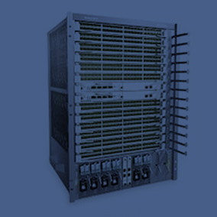

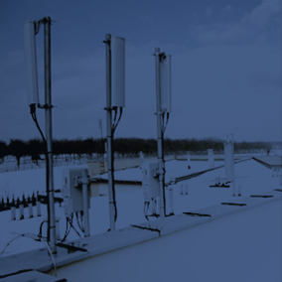
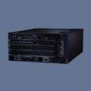




Digital Technologies: One-Stop, World-Leading Cloud-Pipe-Device Synergy
Cloud
Cloud operating system
"A strong performer in the global private cloud software market"
Source: Forrester
Server
Listed as the Challenger in the Magic Quadrant in 2016
Source: Gartner
Storage
Positioned in the Leaders quadrant
Source: Gartner
Campus switch
Ranking 2nd in the global market, with a YoY growth rate of 61%
Source: IDC
Data center switch
Ranking 3rd in the global market, with a YoY growth rate of 82%
Source: IDC
Enterprise router
Ranking 2nd in the global market and 1st in China's market
Source: IDC
Pipe
LTE
91 members in the eLTE industry alliance
Security product
YoY revenue growth rate of 81%
Source: IDC
WLAN
Ranking 3rd in China's enterprise network market
Source: IDC
Device
Broadband trunking terminal
iF Design Award
Videoconferencing
Market share of 40.3%, ranking 1st in China
Source: IDC
Unified communications
Ranking 1st in China with the IP voice market share of 20.1% and call center of 17.1%
Source: IDC

Slide 37












Open Digital Platform, Enabling Smart Applications
Three platforms
Big Data support platform
City operation management platform
Application support platform
One cloud
Cloud data center
Two networks
City communication network
City IoT
Cloud
Pipe
Device

Slide 38







































Cooperative, Win-Win, and Open Ecosystem
High-level design
System integration
Investment and financing
Operations
Platform
Application

Slide 39



Smart City Construction Path
Strategic planning
Solution design
Implementation
120+
Project success experience
20+ years
Consulting and planning experience
30+ years
Delivery experience and engineering services
Feasibility analysis
Conceptual design
High-level design
Bidding and procurement
Low-level design
Construction and operations

Slide 40

Key Success Factors for Smart City Construction
Top-leadership projects
Strong execution teams
Industry-leading digital partners
Solid investments
Breaking data silos
and restructuring processes
High-level planning, coordinated construction, and iterative evolution
Technology, platform, ecosystem, and experience
Sufficient investments with reasonable ROI

